Slide 1

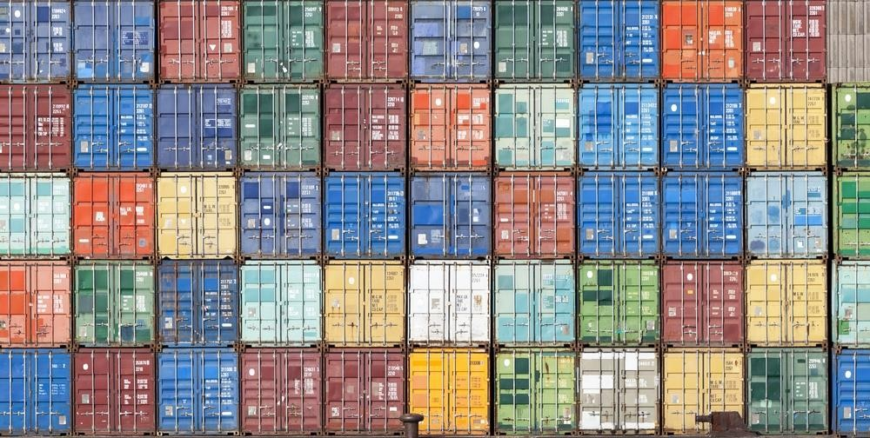
Containers 101 Course
Shon Paz,
Sr. Solution Architect, Red Hat
spaz@redhat.com

Slide 2
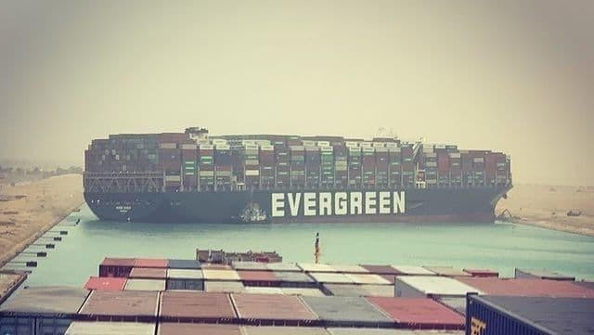
Agenda
Open-Source & An Architectural Change
Container World Introduction
Hands-On Lab #1
Break
Containers Deep-Dive & DevOps
Hands-On Lab #2
Closure

Slide 3

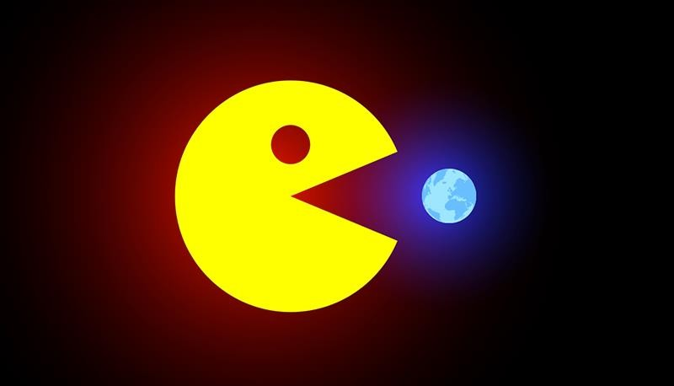
Software Is Eating The World

Slide 4
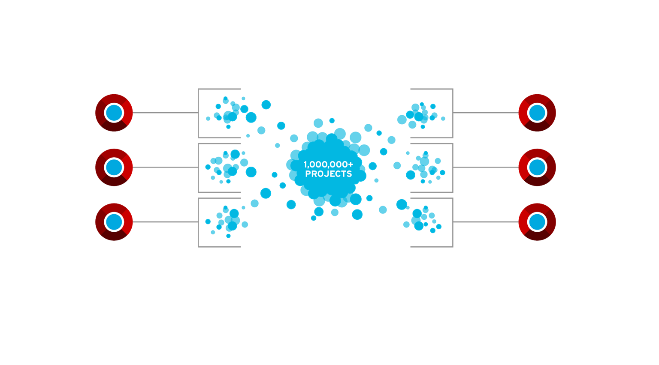
Open Source As an Enabler
Participate
We participate in and create community-powered upstream projects.
Integrate
We integrate upstream projects, fostering open community platforms.
Stabilize
We commercialize these platforms together with a rich ecosystem of services and certifications.

Slide 5
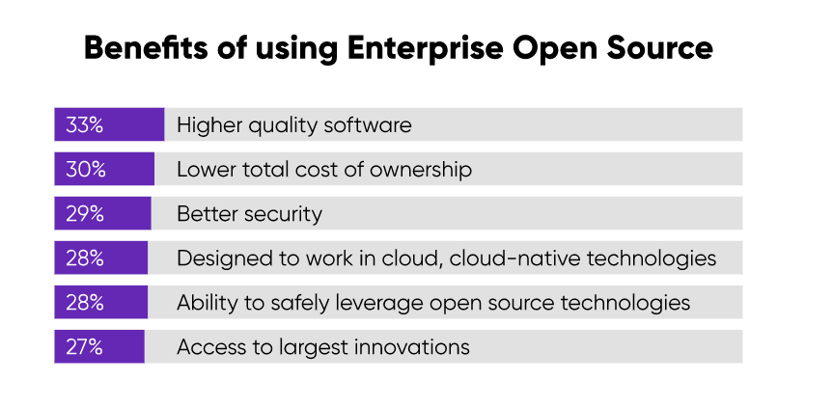

Slide 6

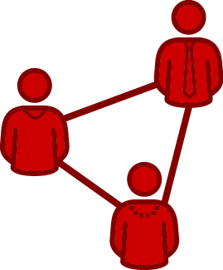
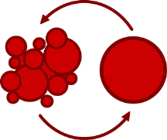

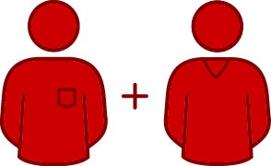

Open Source In Practice
Collaboration
Shared problems are solved faster
Transparency/Security
(both access and the ability to act)
Working together creates standardization
5
F16625-200131

Slide 7
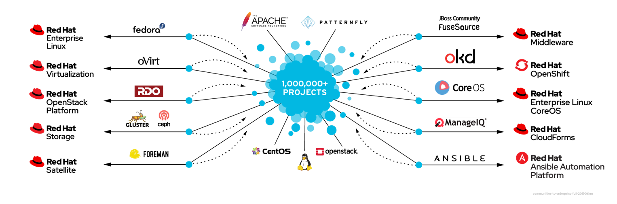
Red Hat As an Open Source Leader
7
F16625-200131

Slide 8
An Architectural Change

Slide 9
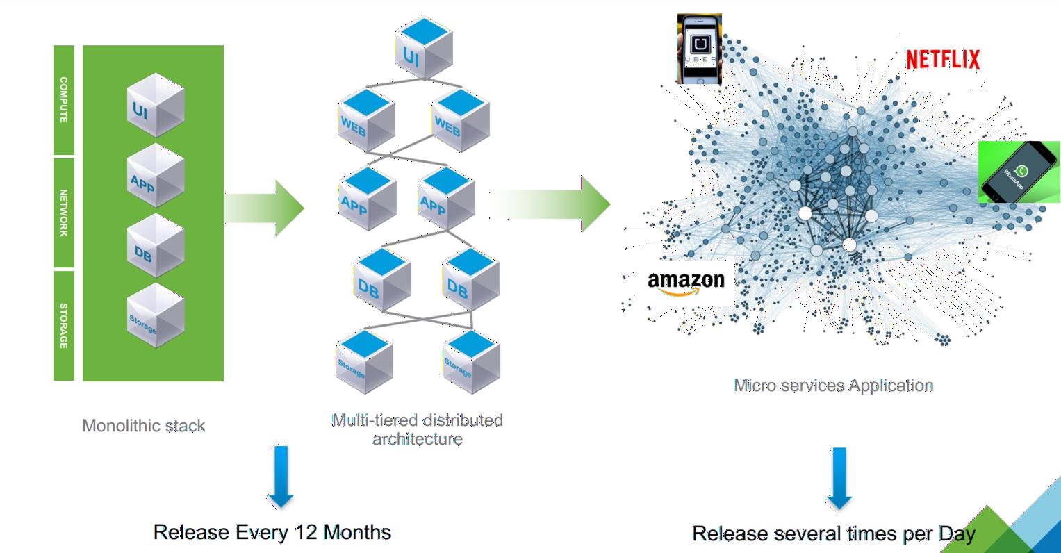
Monolith vs. Microservices

Slide 10

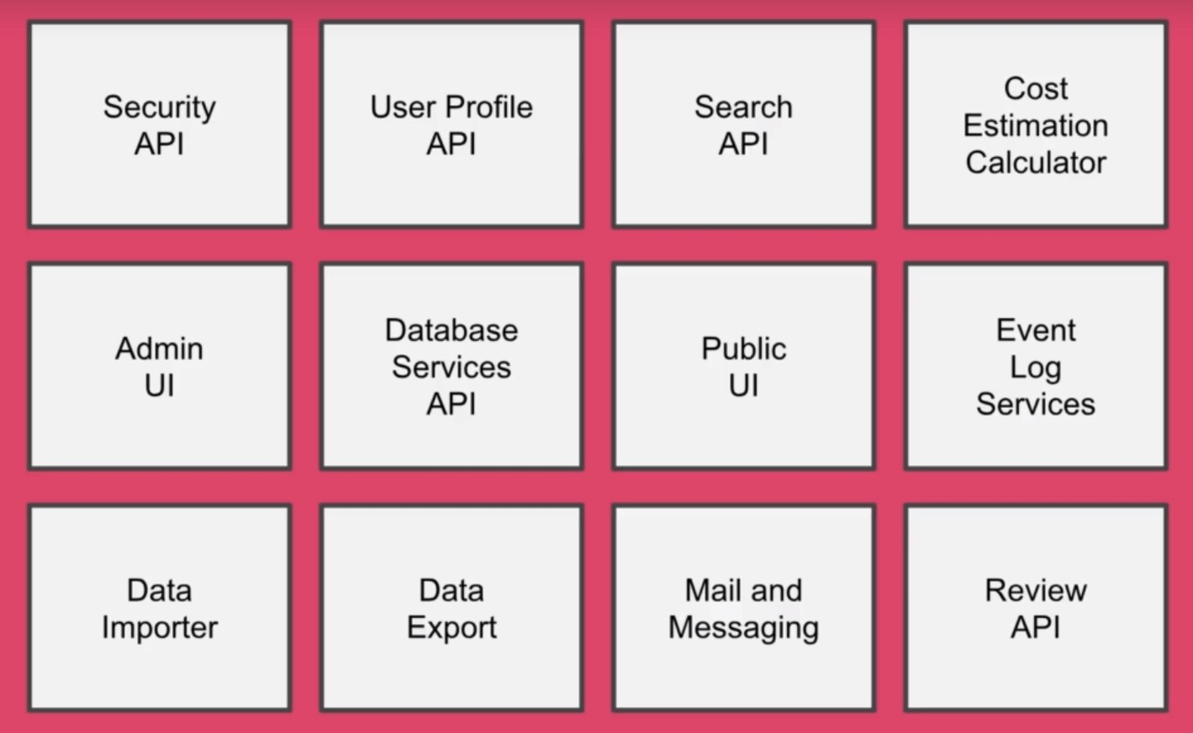

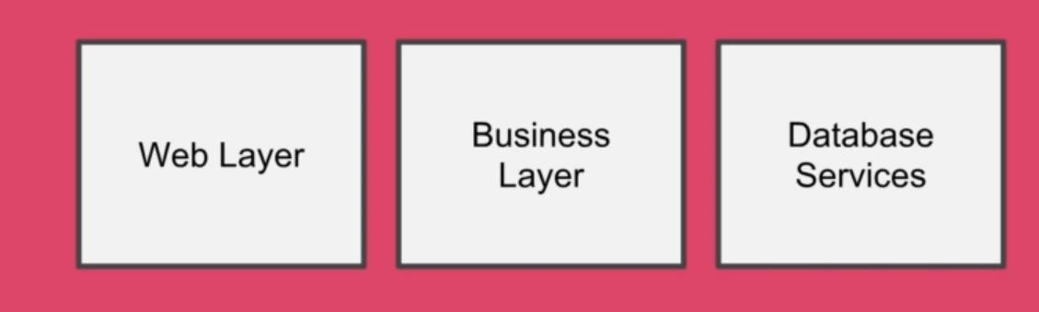
Separate As Much As You Can

Slide 11
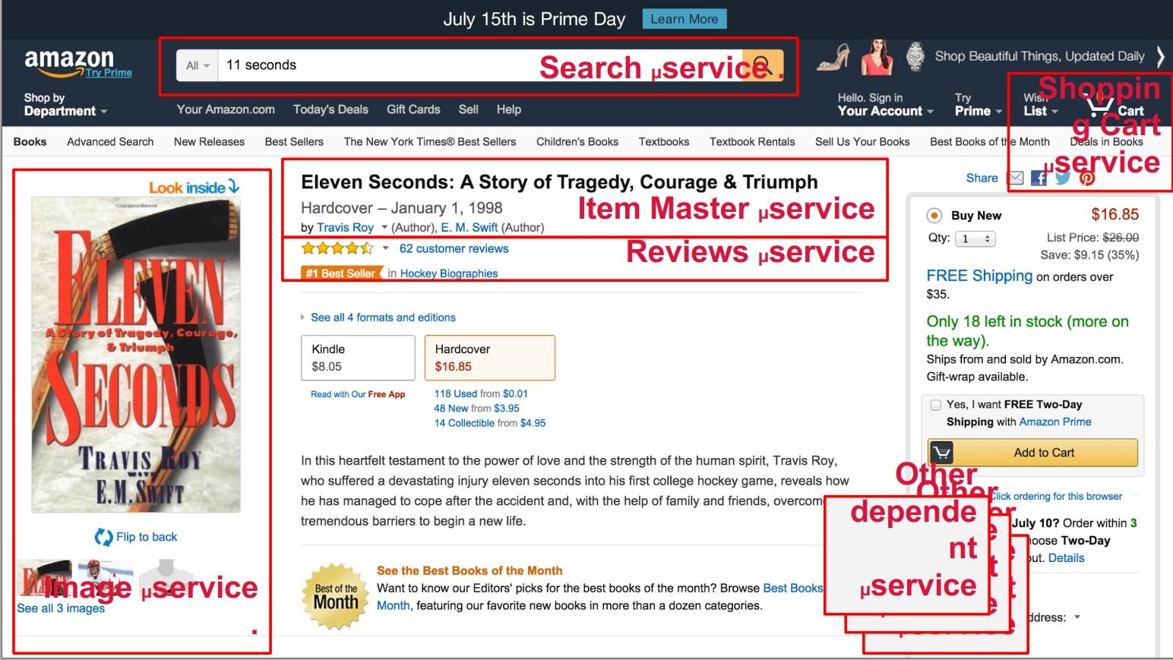
Microservices-ל ךרדה

Slide 12
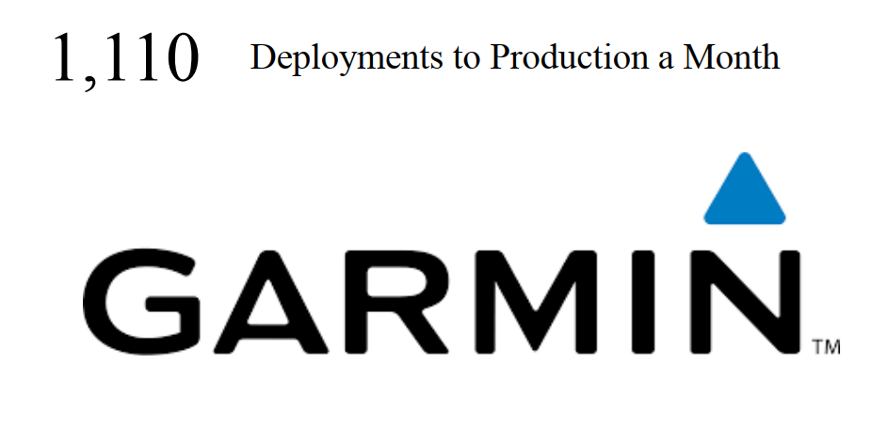
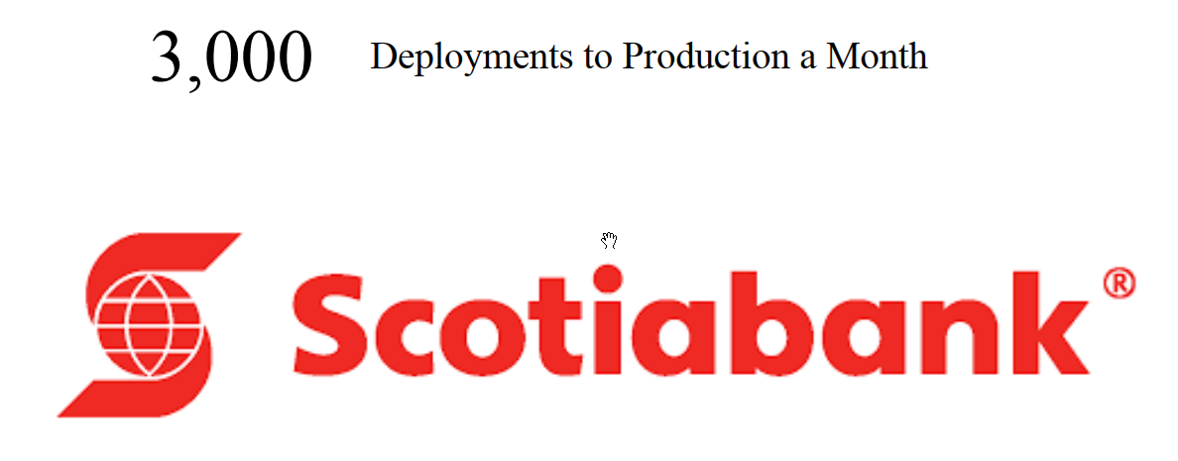
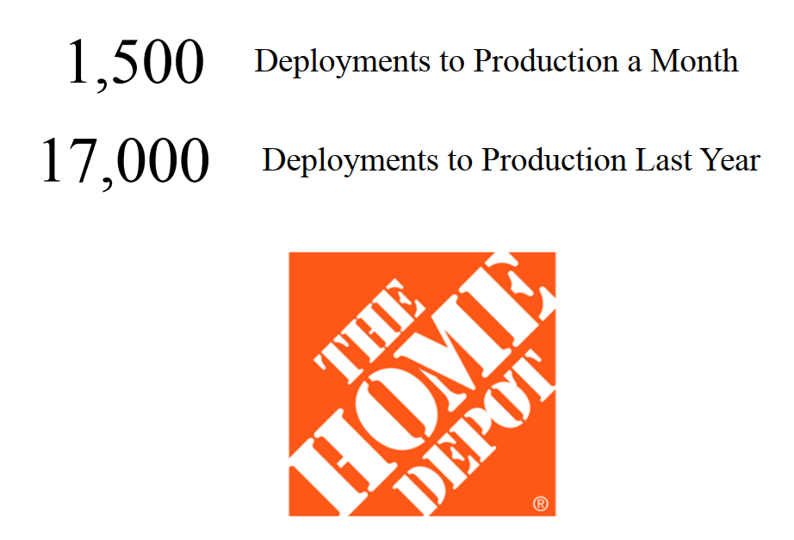


Slide 13
Microservices In Practice

Slide 14
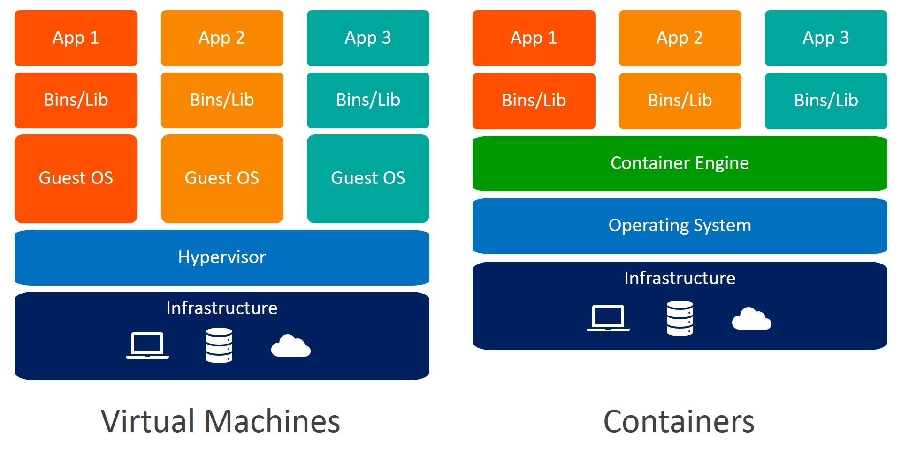
Virtual Machines vs. Containers

Slide 15
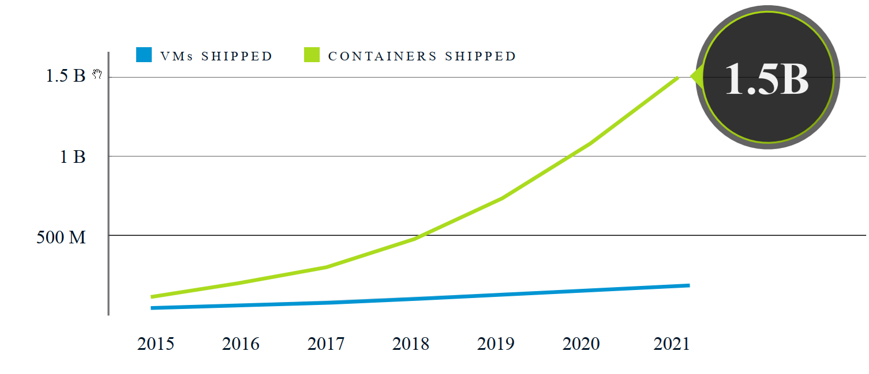
Container Adoption Scalability

Slide 16

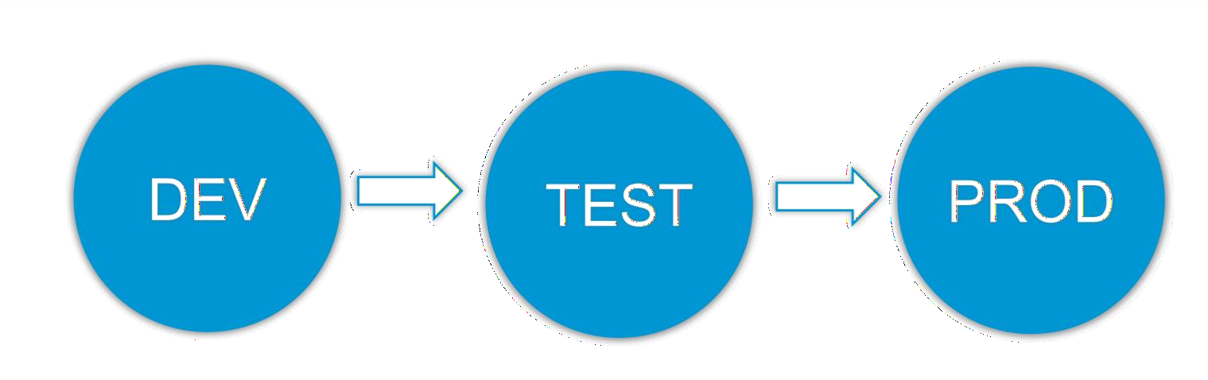
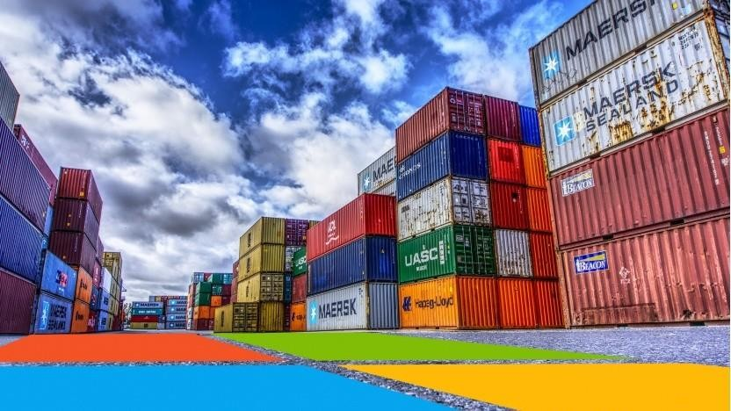
Containers As a Portable Ecosystem

Slide 17
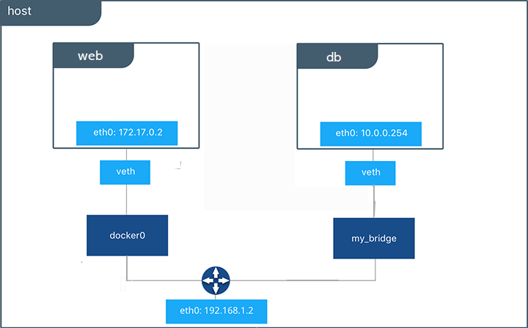
Hands-On Lab #1
Getting Familiar With Containers - Exercise 1

Slide 18
Containers Deep-Dive

Slide 19
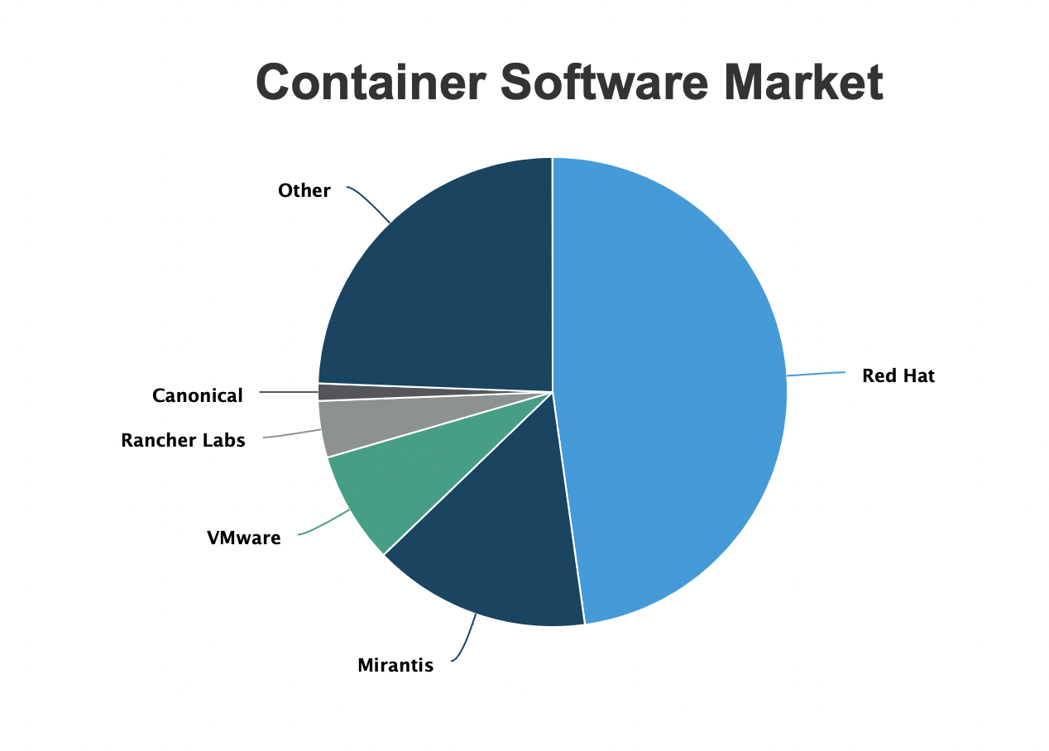

Slide 20
OPENSHIFT & KUBERNETES CONCEPTS
a container is the smallest compute unit
CONTAINER

Slide 21
OPENSHIFT & KUBERNETES CONCEPTS
containers are created from container images
IMAGE
CONTAINER
BINARY
RUNTIME

Slide 22
container images are structured in layers
OPENSHIFT & KUBERNETES CONCEPTS
Image Layer 3
Application Layer
Image Layer 2
Java Runtime Layer
Image Layer 1
OS Update Layer
Base Image
Base RHEL
Container Image Layers
Example Container Image

Slide 23
anatomy of a Dockerfile
OPENSHIFT & KUBERNETES CONCEPTS
FROM registry.access.redhat.com/ubi8/ubi
1
Inherit from a base image
ENV foo=text
2
Parameters as environment variables
RUN dnf install -y java-11-openjdk
3
Install dependencies (tooling from base image)
ADD my-app.jar /home/my-app.jar
4
Add your app as a new Layer
EXPOSE 8080
5
Expose the port your app will use
CMD java -jar /home/my-app.jar
6
Run the app
Example for Java app

Slide 24
OPENSHIFT & KUBERNETES CONCEPTS
container images are stored in an image registry
IMAGE REGISTRY
IMAGE
IMAGE
IMAGE
CONTAINER
IMAGE
IMAGE
IMAGE

Slide 25
OPENSHIFT & KUBERNETES CONCEPTS
an image repository contains all versions of an image in the image registry
IMAGE REGISTRY
myregistry/frontend
myregistry/mongo
frontend:latest
frontend:2.0
frontend:1.1
frontend:1.0
mongo:latest
mongo:3.7
mongo:3.6
mongo:3.4
IMAGE
IMAGE
IMAGE
IMAGE
IMAGE
IMAGE
IMAGE
IMAGE

Slide 26
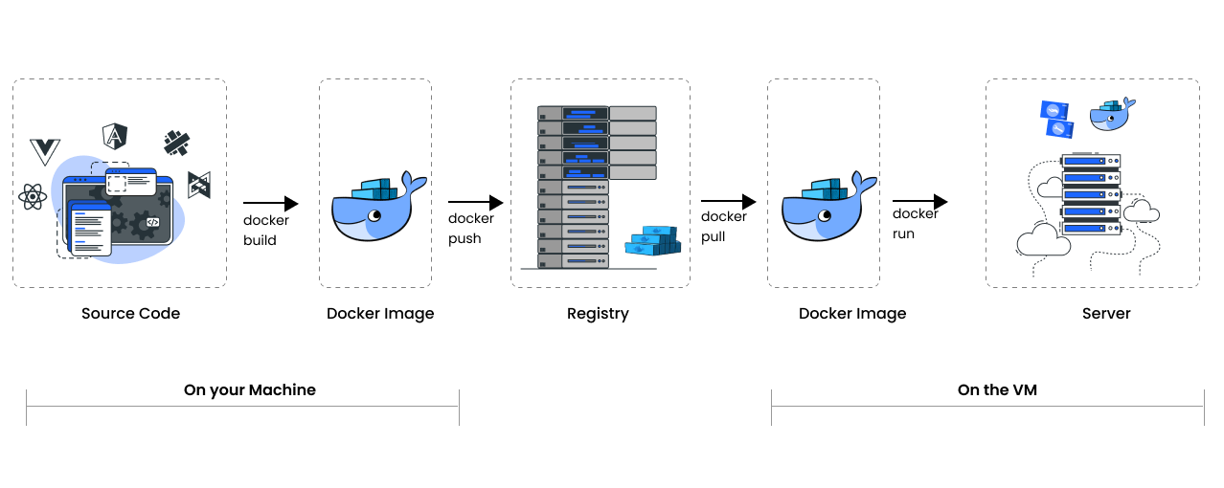
Semi-Automated Pipeline

Slide 27
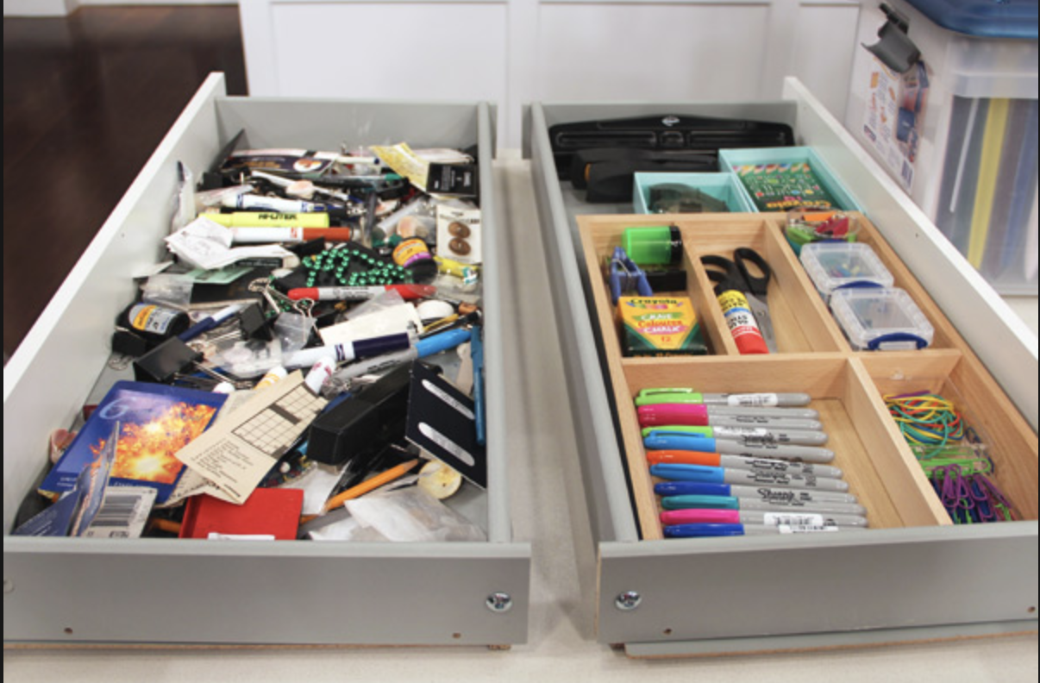
Development vs. Operations
Expertise in many differents areas (langs, tool, tech)
Lack of tests
Pure documentation
Just fix it, do not touch it if it's works
Same language, tools, tech
Unit tests, integration tests, manual testing, etc
At worse case, code is your documentation
Well defined development life cycle

Slide 28
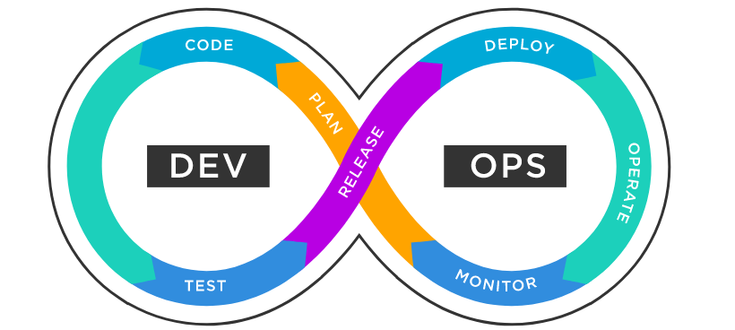
DevOps For The Rescue

Slide 29
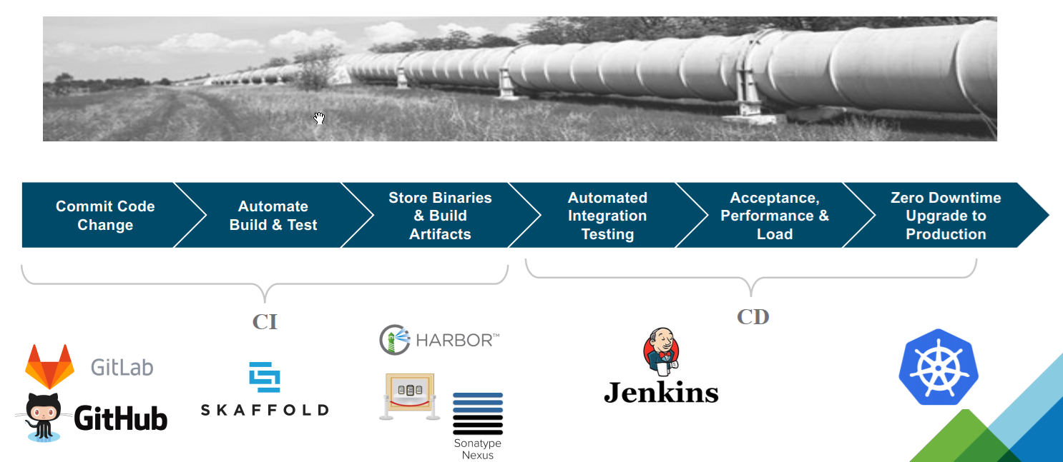
CI/CD Pipelines

Slide 30
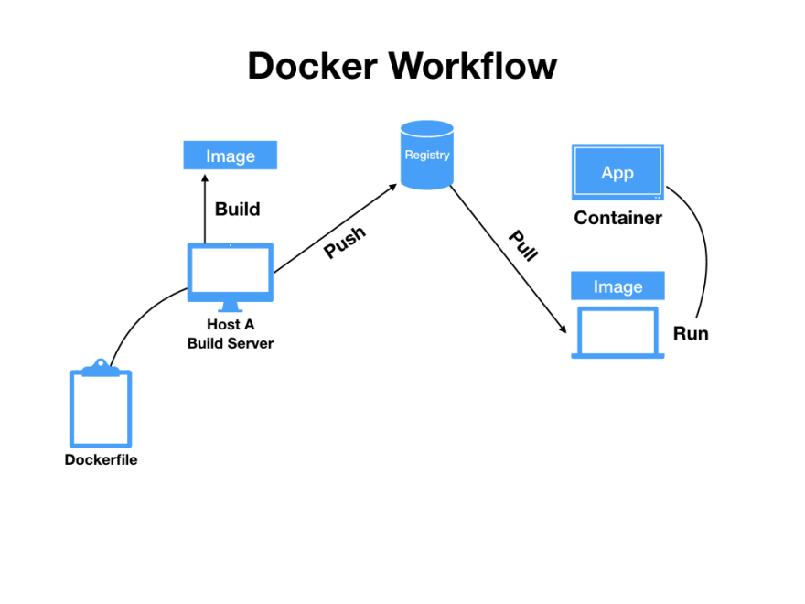
Hands-On Lab #2
Getting Familiar With Containers - Exercises 2+3

